Slide 1
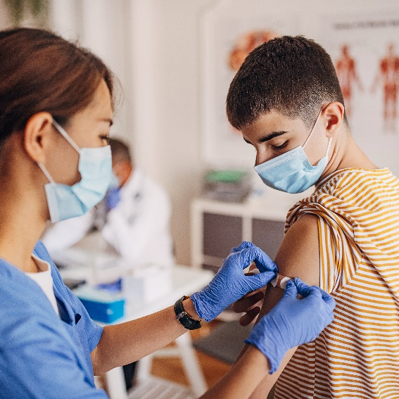
Physical and Emotional Changes During Puberty (recommended for grade 4)
Created by: Child Health Team
Created: November 2019
Updated: March 2020
Notes:
This presentation addresses topic areas of the Human Development and Sexual Health section D1.5 of the Grade 4 Ontario Health and Physical Education Curriculum.
To provide an inclusive environment for all students, regardless of their gender identity, we use the names of body parts and hormones to discuss physical differences rather than the use of gender.

Slide 2
Class Guidelines
Giggling is okay
Be respectful
Everyone is learning, ask questions!
Discuss puberty topics responsibly outside the classroom
Notes:
Ask students to contribute ideas to add to the guidelines

Slide 3
What is puberty?
Time of change from child to adult
Physical changes
Emotional changes
In some cultures, it is a celebrated right of passage
Notes:
There are 3 major growth spurts: 1-the development of a baby before birth, 2-birth to one year old, 3-PUBERTY
Consider asking the class about ceremonies or celebrations that might be celebrated in their families related to puberty

Slide 4
When does puberty start and why?
Puberty begins when youth are between 8-15 years old
The brain sends a signal to the reproductive organs to produce hormones
These hormones cause physical and emotional changes
Notes:
Everyone’s body is different. For example, people are different heights and have different hair colour, it is normal for not everyone to look the same.
When puberty starts and how long the process takes can vary greatly from one person to the other, which is something we don’t have control over and is completely okay.
Image source: https://pixabay.com/vectors/brain-anatomy-man-mind-people-154297/

Slide 5
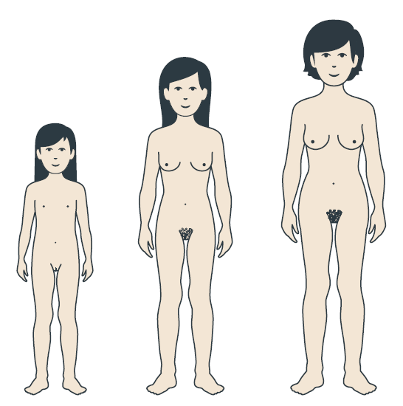
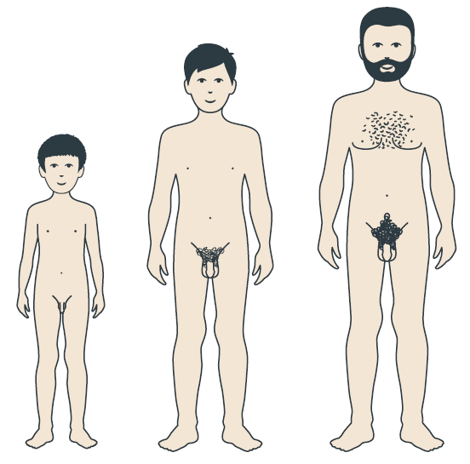
Person with a penis
Person with a vulva
Testosterone
Estrogen
Notes:
The penis and vulva are the external/visible part of the reproductive anatomy (point to penis and vulva for clarification). Many different words are used for these body parts, penis and vulva are the anatomical names.
In a person with a penis, the signal is sent to the testicles to create testosterone
In a person with a vulva, the signal is sent to the ovaries to create estrogen
Testosterone and Estrogen cause changes in the body
Image Source: https://www.secca.org.au/ with permission

Slide 6
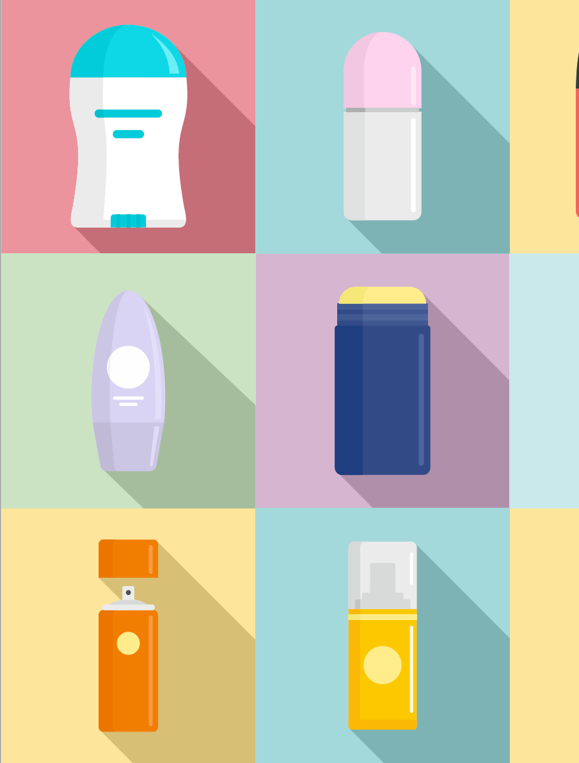
What changes can happen to everyone?
Growing
Bones and muscles grow, get taller
Weight gain
Skin and hair can become oiler
Acne (face, back, chest)
Sweat and body odour
Notes:
Weight gain is very normal during puberty
Acne (pimples/zits)-common places to see acnes are the face, chest and back.
Acne cannot always be prevented but washing with a mild soap regularly can help.
You may need to change how often you wash your hair if its very oily.
Sweat- different sweat glands start to work during puberty, and they produce a smell (sometimes referred to as body odour).
Showering regularly and using deodorant can reduce body odour.
Deodorant helps control odour, antiperspirant helps control sweating.
-It is important to note that the acceptance of body odour varies across cultures
Image source: Adobe Stock-purchased (MLHU)

Slide 7
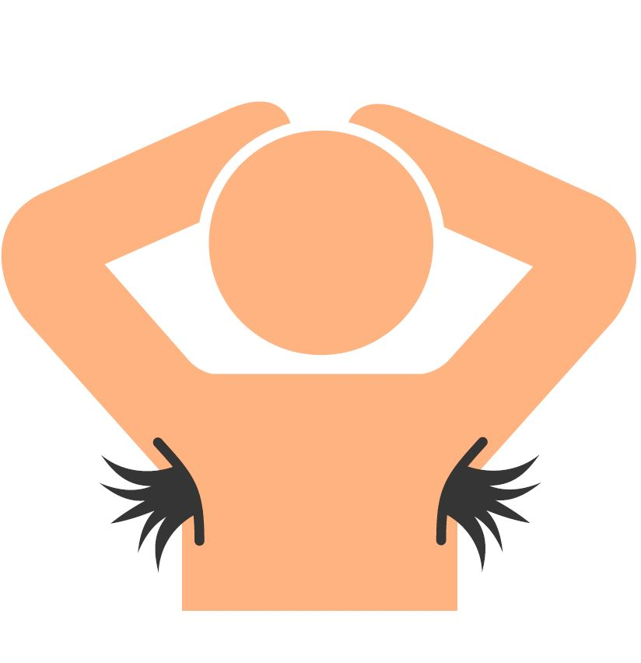
What changes can happen to everyone?
Hair growth
Underarm and pubic areas
Darker hair on arms and legs
Voice changes
Changes in mood
Notes:
Hair growth-hair removal or shaving is a personal decision and often family values influence choices about body hair.
If students have questions about this, recommend they chat with a trusted adult in their lives about this decision.
Image source: Adobe Stock-purchased (MLHU)

Slide 8
What changes can happen to a person with a penis?
Testosterone causes:
Hair to grow on the face, chest and back
Testicles and penis to get bigger
Voice to deepen

Slide 9
What changes can happen to a person with a vulva?
Estrogen causes:
Breasts and nipples to get larger
Hips to get wider and more curvy
Menstruation (period) to start

Slide 10
What is menstruation (a period)?
A person who has a vulva and a uterus will begin to get a period
Blood and tissue leave the body through the vagina
Happens about every month
Lasts 2-7 days
Notes:
-Menstruation starts during puberty, may not happen every month at first (every 21-45 days)
(For more detailed information on the menstrual cycle and a diagram of the uterus, see our Puberty and Reproduction presentation)

Slide 11
Feelings
Everyone has different feelings during puberty…this is completely normal!
What are some of the feelings you might experience?

Slide 12
Notes:
You may have mood swings
You may love your friends or family at times and not want to have anything to do with them at other times.
Sometimes you may feel grown-up, other times like a kid.
There may be lots of tears and arguments.
Changing hormones cause some of these feelings.
Image source: Wordart.com

Slide 13
How can puberty affect relationships?
Changing interests may change friendships
Some people start “liking” others
Might be treated like they are older because of their changing body
Teasing
Notes:
Everyone “should be treated in an age-appropriate and respectful way” (Ontario Curriculum, Grades 1-8; Health and Physical Education 2019)
It is not okay to tease people about changes related to puberty, do not draw attention to changes someone might be experiencing or make them self conscious.

Slide 14
Where can you get more information?
Parents or other family members
Other trusted adults (teachers)
Health professionals
Notes:
Parents can be a really good source of information when it comes to changes during puberty. They can answer questions and give great advice. Students are encouraged to share what they have learned with their parents and ask a trusted adult to answer any of their questions regarding puberty.

