Slide 1
Alcohol

Slide 2
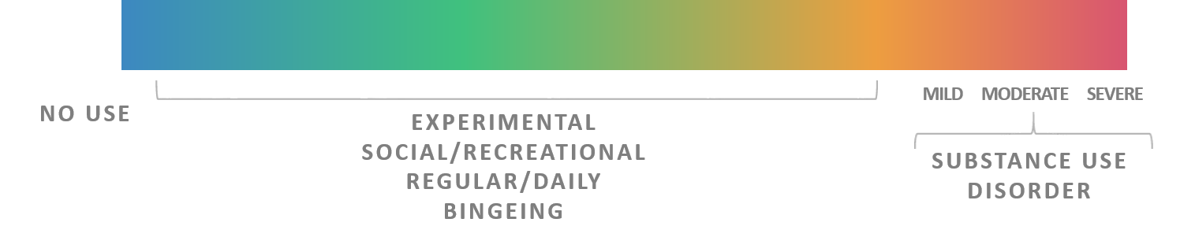
Substance use Continuum
When does substance use become a problem?
No Problems
Minimal Problems
Serious Problems
Many Problems
Notes:
People will vary in their substance use consumption patterns, ranging from:
Never consuming cannabis (abstinent)
Experimental Use: has tried a substance one or several times. Use can be motivated by curiosity about the drug effect and peer influence
Occasional consumption with very little negative effects - use is irregular, usually confined to special occasions (holidays, birthdays etc.) or when opportunities present themselves directly. Availability, accessibility and affordability influence use
Regular consumption with very little negative effects – use has a predictable pattern, which may entail frequent or infrequent use. The user actively seeks to experience the drug effect, or to participate in the drug-taking activities of the peer group. Usually they feel in control of the drug use (i.e. can take it or leave it)
Regular consumption accompanied by difficulties in their lives due to consumption (around 10% of cannabis- alcohol consumers) – Dependence: use is regular and predictable, and usually frequent. The user experiences a physiological and/or psychological need for the drug. They feel out of control in relation to its use, and will continue to use despite adverse consequences. Drugs often are used when alone, and daily activities may be planned around drug use.
People may move along the continuum of cannabis consumption forwards and backwards, ranging from abstinence to regular consumption over time. Why might someone move to different stages: see parents doing it, easy access, friend talking about having tried it, curiosity, see teens using on TV, see it as the “norm” to do at parties, to fit in, parents allow within the home, to control pain, Decreasing the potential harms associated with cannabis consumption may involve moving down the continuum and reducing consumption, or may involve changing the method of consumption.

Slide 3
Get the Facts!

Slide 4

Myth or FacT?
If a man and a woman are the exact same height and weight, they will feel the effects of alcohol the same way.
MYTH
Women are more sensitive to the effects of alcohol since they have less water in their bodies (to dilute alcohol) and their bodies do not break down alcohol as quickly.
Notes:
Women are anything but equal when we talk about alcohol and we wanted to take a minute to look at the unique characteristics that lead women to distinctive problems associated with alcohol.
Women are generally:
Smaller then men
Have less water in their bodies to dilute alcohol
Have less alcohol dehydrogenase – enzyme that breaks down alcohol in the stomach
Have changing hormone levels that alter how alcohol is processed in our bodies
All of these factors mean that alcohol stays in a woman’s body longer than a man’s and at higher concentrations.
Women are also at ↑ risk for breast cancer (less than1drink/day) and ↑ risk for infertility, menstrual abnormalities, adverse pregnancy outcomes, unplanned pregnancies, sexually transmitted infections
It’s important to remember that alcohol is circulated through the blood to every organ and tissue in the body – a higher alcohol level circulating in the body equals more damage.
References:
Canadian Centre on Substance Use (2014). Women and Alcohol. Retrieved from http://www.ccdus.ca/Resource%20Library/CCSA-Women-and-Alcohol-Summary-2014-en.pdf
Middlesex London Health Unit (2017). Women and Alcohol. Retrieved from https://www.healthunit.com/women-and-alcohol
Rethink Your Drinking (2016). Sex. Retrieved from http://www.rethinkyourdrinking.ca/sex2/

Slide 5
Myth or Fact?
Alcohol is the most common drug used among youth.
#1
FACT
Alcohol is normalized. Sometimes people don’t even view alcohol as a drug. Even though legal drinking age is 19, it’s easily accessible.
Notes:
Reference:
OSDUHS 2017

Slide 6

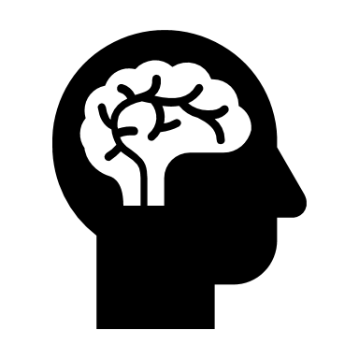
Myth or fact?
Alcohol is a stimulant.
MYTH
Alcohol is a depressant, meaning it reduces functioning of your central nervous system.
Notes:
Reference:
Foundation for a Drug Free World. (2019). What is alcohol. Retrieved from: https://www.drugfreeworld.org/drugfacts/alcohol.html

Slide 7
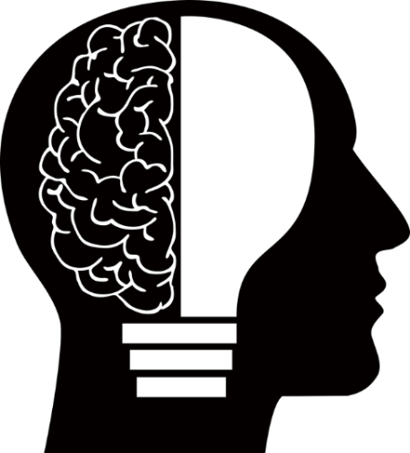
Myth or fact?
Alcohol does not harm brain development after age 19
MYTH
The brain undergoes a considerable amount of development during the teen years and does not fully mature until around the age of 25.
Notes:
Unfortunately, developing brains are generally more prone to damage. This means that experimentation with alcohol and drugs can have lasting, harmful effects on teen brains.
Brain development- The last area to mature is the frontal lobe (prefrontal cortex)- responsible for executive functions- decision making, thinking through consequences of actions, emotional expression, problem solving, memory, language, and judgment/impulse control.
References:
Partnership for Drug Free Kids. (n.d.). Brain Development, Teen Behaviour and Preventing Drug Use. Retrieved from
https://drugfree.org/article/brain-development-teen-behavior/
Winters, K. (2013). Alcohol and Other Drug Use and Adolescent Brain Development. Retrieved from
https://www.oasas.ny.gov/prevention/documents/AdolescentBrain.pdf
Pixabay. (n.d.). Brain. Retrieved from https://pixabay.com/en/anatomy-biology-brain-thought-mind-1751201/

Slide 8
What influences intoxication?
A number of factors can increase your risk of alcohol poisoning, including:
  Your size and weight
  Your overall health
  Whether you've eaten recently
  Whether you're combining alcohol with other drugs
  The percentage of alcohol in your drinks
  The rate and amount of alcohol consumption
  Your tolerance level
  Whether you are male or female
Notes:
References:
Alberta Health Services (2014). Alcohol and the Human Body: Short-term Effects. Retrieved from https://www.albertahealthservices.ca/assets/info/hp/edu/if-hp-edu-amh-alcohol-and-the-human-body.pdf
Butt et. al (2011). Alcohol and Health in Canada: A Summary of Evidence and Guidelines for Low-Risk Drinking. Retrieved from http://www.ccdus.ca/Resource%20Library/2011-Summary-of-Evidence-and-Guidelines-for-Low-Risk%20Drinking-en.pdf

Slide 9

Myth or fact?
Vomiting is a sign of alcohol poisoning
FACT
One of the body’s ways of dealing with alcohol poisoning is eliminating the unabsorbed alcohol from the stomach via vomiting
Notes:
Alcohol is a toxin to the body and as you take in more of it, the body has more difficulty filtering it out. This build up of toxin leads to the feeling of being drunk and also leads to many serious health risks.
-Increased risk for alcohol poisoning with binge drinking. Often occurs when people take part in a funneling or chugging contest and drinking games. You stop realizing how much alcohol you have taken in as you get more excited and invested in these “games”
References:
Canadian Public Health Association. (n.d.). Binge drinking and alcohol poisoning: straight talk for parents. Retrieved from
http://www.cpha.ca/en/programs/portals/substance/article02.aspx
Centre for Addiction and Mental Health. (2008). Partying and Getting Drunk [Brochure]. Toronto, ON. Retrieved from
http://www.camh.ca/en/education/about/camh_publications/Pages/binge_drinking.aspx
Centers for Disease Control and Prevention. (2012). Fact Sheets – Binge Drinking. Retrieved from
http://www.cdc.gov/alcohol/fact-sheets/binge-drinking.htm

Slide 10
Symptoms of Alcohol Poisoning
Passing out, semi conscious
Cold, pale, bluish skin
Vomiting while sleeping
Slow breathing
Seizures
Incontinent of urine
Notes:
Alcohol Poisoning occurs when drinking large quantities of alcohol within a short period of time
Depresses nerves that control involuntary actions such as breathing and the gag reflex
Funneling, Chugging, Drinking Games
References:
Canadian Public Health Association. (n.d.). Binge drinking and alcohol poisoning: straight talk for parents. Retrieved from
http://www.cpha.ca/en/programs/portals/substance/article02.aspx
Centre for Addiction and Mental Health. (2008). Partying and Getting Drunk [Brochure]. Toronto, ON. Retrieved from
http://www.camh.ca/en/education/about/camh_publications/Pages/binge_drinking.aspx
Centers for Disease Control and Prevention. (2012). Fact Sheets – Binge Drinking. Retrieved from
http://www.cdc.gov/alcohol/fact-sheets/binge-drinking.htm
Middlesex London Health Unit (2017). Binge-Drinking & Alcohol poisoning. Retrieved from https://www.healthunit.com/binge-drinking

Slide 11



Myth or fact?
Alcohol poisoning only happens when you drink over 20 drinks in a night
MYTH
Alcohol poisoning can happen at much lower level of alcohol consumption
Notes:
References:
Canadian Public Health Association. (n.d.). Binge drinking and alcohol poisoning: straight talk for parents. Retrieved from
http://www.cpha.ca/en/programs/portals/substance/article02.aspx
Centre for Addiction and Mental Health. (2008). Partying and Getting Drunk [Brochure]. Toronto, ON. Retrieved from
http://www.camh.ca/en/education/about/camh_publications/Pages/binge_drinking.aspx
Centers for Disease Control and Prevention. (2012). Fact Sheets – Binge Drinking. Retrieved from
http://www.cdc.gov/alcohol/fact-sheets/binge-drinking.htm
Middlesex London Health Unit (2017). Binge-Drinking & Alcohol poisoning. Retrieved from https://www.healthunit.com/binge-drinking

Slide 12

Myth or fact?
When you find someone unconscious from drinking too much- put them to bed and let them sleep it off.
MYTH
This is a sign of alcohol poisoning
*get medical help and call 911.
Notes:
References:
Canadian Public Health Association. (n.d.). Binge drinking and alcohol poisoning: straight talk for parents. Retrieved from
http://www.cpha.ca/en/programs/portals/substance/article02.aspx
Centre for Addiction and Mental Health. (2008). Partying and Getting Drunk [Brochure]. Toronto, ON. Retrieved from
http://www.camh.ca/en/education/about/camh_publications/Pages/binge_drinking.aspx
Centers for Disease Control and Prevention. (2012). Fact Sheets – Binge Drinking. Retrieved from
http://www.cdc.gov/alcohol/fact-sheets/binge-drinking.htm
Middlesex London Health Unit (2017). Binge-Drinking & Alcohol poisoning. Retrieved from https://www.healthunit.com/binge-drinking

Slide 13
Action
Recovery position
Call 911
Stay with the person until help arrives
NEVER leave the person to sleep it off
Notes:
Reference:
Middlesex London Health Unit (2017). Binge-Drinking & Alcohol poisoning. Retrieved from https://www.healthunit.com/binge-drinking

Slide 14
Recovery Position
Notes:
You may want to have students demonstrate if there is time.
Bacchus Maneuver©: The Student Life Education Company, BACCHUS Canada. Reviewed 2011 Healthy Communities & Injury Prevention Team.

Slide 15

Myth or Fact…
Drinking coffee (caffeine) will help you sober up quicker
MYTH
No amount of food or drink can change its effects. Time is the only way to sober up
Notes:
“Caffeine has no effect on the metabolism of alcohol by the liver and thus does not reduce breath or blood alcohol concentrations (it does not “sober you up”) or reduce impairment due to alcohol consumption”.
Reference:
Centers for Disease Control and Prevention. (2018). Fact sheets: Alcohol and caffeine. Retrieved from: https://www.cdc.gov/alcohol/fact-sheets/caffeine-and-alcohol.htm

Slide 16
Alcohol and Energy Drinks
Grade 7-12 Students use of High-caffeine Energy Drinks – 34.1% (OSDUHS 2017)
When alcohol is mixed with caffeine, the caffeine can mask the depressant effects of alcohol, making drinkers feel more alert than they would otherwise.
As a result, they may drink more alcohol and become more impaired than they realize, increasing the risk of alcohol-attributable harms.
Caffeine does not sober you up
Notes:
References:
Centre for Addiction and Mental Health (2017). Ontario Student Drug Use and Health Survey. Retrieved from http://www.camh.ca/en/research/news_and_publications/ontario-student-drug-use-and-health-survey/Documents/2017%20OSDUHS%20Documents/Summary_DrugUseReport_2017OSDUHS.pdf
Canadian Centre on Substance Use and Addiction (2018). Alcohol and Caffeine. Retrieved from http://www.ccsa.ca/Eng/topics/alcohol/Alcohol-and-caffeine/Pages/default.aspx
Middlesex London Health Unit (2017). Alcohol and Energy Drinks. Retrieved from https://www.healthunit.com/alcohol-and-energy-drinks

Slide 17

Myth or fact?
Youth who binge drink are more than 2x as likely to have unplanned sex, than those who do not
FACT
Drinking 4 or more drinks of alcohol at one time will lower your inhibitions, alter your thinking, and affect your decisions/actions
Notes:
References:
Krieger, H., Young, C., Anthenien, A. & Neighbors, C. (2018). The epidemiology of binge drinking among college-age individuals in the United States. Alcohol Research, 39(1), 23-30. Retrieved from: https://www.ncbi.nlm.nih.gov/pmc/articles/PMC6104967/
Centers for Disease Control and Prevention. (2012). Fact Sheets – Binge Drinking. Retrieved from
http://www.cdc.gov/alcohol/fact-sheets/binge-drinking.htm

Slide 18
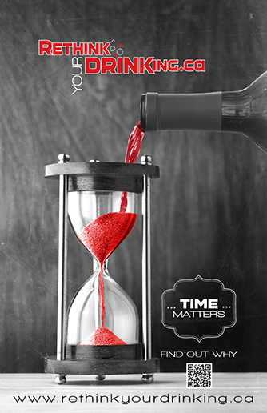
Immediate Health Risks
Violence
Risky sexual behaviours
Alcohol poisoning
Injuries to self or others
FASD
Notes:
Alcohol use has many immediate effects that increase the risk of harmful health and social conditions.
Violence – fights, intimate partner violence
Risky Sexual Behaviours – unprotected sex, sex with multiple partners, and increased risk of sexual assault. These behaviors can result in unintended pregnancy or sexually transmitted infections
Alcohol poisoning – which is a medical emergency
Unintentional injuries – traffic crashes (drunk driving), falls, drowning, burns, and unintentional firearm injuries.
Fetal Alcohol Spectrum Disorder – It is recommended that women who are pregnant or trying to get pregnant avoid drinking alcohol.
FASD can cause a range of disabilities that result from prenatal alcohol exposure including brain damage, learning disabilities, hearing difficulties, vision difficulties, organ damage, slow growth, and poor bone development.
FASD is 100% preventable.
TIME MATTERS – the less time between drinks, the slower the effects wear off , it takes anywhere from 1 hour to 1.5 hours for the body to clear one standard alcoholic drink.
References:
Centre for Addiction and Mental Health (2017). Ontario Student Drug Use and Health Survey. Retrieved from http://www.camh.ca/en/research/news_and_publications/ontario-student-drug-use-and-health-survey/Documents/2017%20OSDUHS%20Documents/Summary_DrugUseReport_2017OSDUHS.pdf
Middlesex London Health Unit (2017). Reduce Your Alcohol Risks. Retrieved from https://www.healthunit.com/reduce-your-alcohol-risks
Rethink Your Drinking (2016). Health Effects. Retrieved from http://www.rethinkyourdrinking.ca/risks/

Slide 19
Myth or fact?
Drinking Alcohol reduces the risk of cancer.
MYTH
There is strong evidence of alcohol consumption and cancers of the esophagus, larynx, oral cavity and breast cancer in women.
Notes:
References:
Canadian Centre on Substance Use and Addiction. (2019). Canada’s low-risk alcohol drinking guidelines: Frequently asked questions. Retrieved from: https://ccsa.ca/sites/default/files/2019-04/2012-FAQs-Canada-Low-Risk-Alcohol-Drinking-Guidelines-en.pdf
Middlesex London Health Unit (2017). Drinking Alcohol-Short and Long Term Risks. Retrieved from https://www.healthunit.com/risks-of-drinking
Rethink Your Drinking (2016). Health Effects. Retrieved from http://www.rethinkyourdrinking.ca/risks/

Slide 20
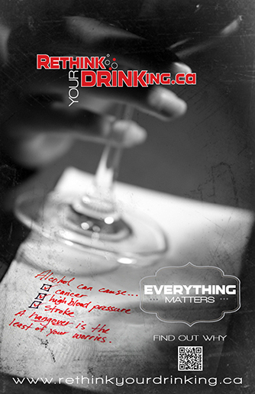
Long Term Health Risks
Cardiovascular Problems
Mental Health
Social Problems
Neurological Problems
Liver Disease/Gastrointestinal Problems
Cancer
Notes:
When we think of alcohol related harms, we often think of things like drunk driving crashes, a bar fight, or struggling with a hangover the next day – those immediate effects like on the pervious slides.
What we don’t always realize is that alcohol use can lead to many long-term health problems such as:
Cardiovascular problems – heart attack, heart disease and high blood pressure
Mental Health– alcohol dependence, depression, anxiety, and suicide. What comes first-the substance use issue or the mental health concern-varies and may be difficult to determine. The two are often intertwined and related.
Social problems – unemployment, lost productivity, financial crisis, and family/friend difficulties.
Neurological problems – dementia and stroke. We will talk about the impact on the teen brain next.
Liver disease and other gastrointestinal problems
Cancer – Cancer is often surprising to the public – even though it was first linked to alcohol in the late 1980s – this includes cancers of the head & neck, liver, colon, and breast. In general, the risk of cancer rises with increasing amounts of alcohol. If you drink & smoke cigarettes, the risk of developing certain cancers is even greater.
It’s important to remember that alcohol is circulated through the blood to every organ and tissue in the body and therefore effects every organ and tissue in the body.
References:
Middlesex London Health Unit (2017). Drinking Alcohol-Short and Long Term Risks. Retrieved from https://www.healthunit.com/risks-of-drinking
Rethink Your Drinking (2016). Health Effects. Retrieved from http://www.rethinkyourdrinking.ca/risks/

Slide 21
Myth or fact?
There are health risks to someone who has only 2 drinks a day
FACT
Drinking any amount of alcohol has risks, you can lower risk by following the Low Risk Guidelines
Notes:
References:
Canadian Centre on Substance Use and Addiction (2018). Drinking Guidelines. Retrieved from http://www.ccsa.ca/Resource%20Library/2012-Canada-Low-Risk-Alcohol-Drinking-Guidelines-Brochure-en.pdf

Slide 22
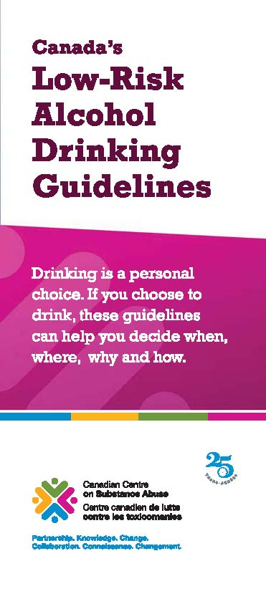
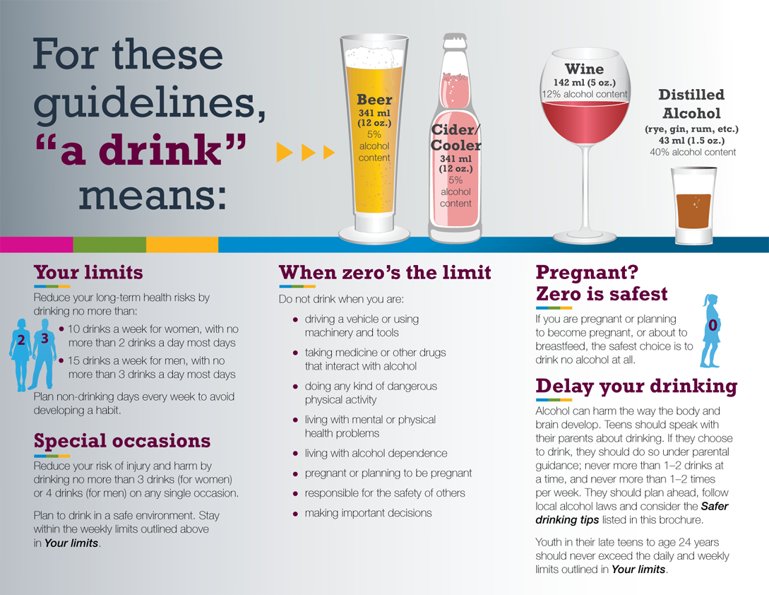
Low-Risk Alcohol Drinking Guidelines
Notes:
In 2011 Canada developed one national set of low-risk alcohol drinking guidelines, with the support of federal, provincial and territorial health ministers, as well as many respected Canadian organizations.
These guidelines, which are intended for Canadians of legal drinking age who choose to drink alcohol, are informed by the most recent and best available scientific research and evidence. They are intended to provide consistent information across the country to help Canadians moderate their alcohol consumption and reduce their immediate and long-term alcohol-related harm.
The idea is if all Canadian drinkers were drinking alcohol within the proposed guidelines, it is estimated that alcohol-related deaths would be reduced by approximately 4,600 per year.*
There are 5 sections to the LRDGs
Reference:
Canadian Centre on Substance Use and Addiction (2018). Drinking Guidelines. Retrieved from http://www.ccsa.ca/Resource%20Library/2012-Canada-Low-Risk-Alcohol-Drinking-Guidelines-Brochure-en.pdf

Slide 23
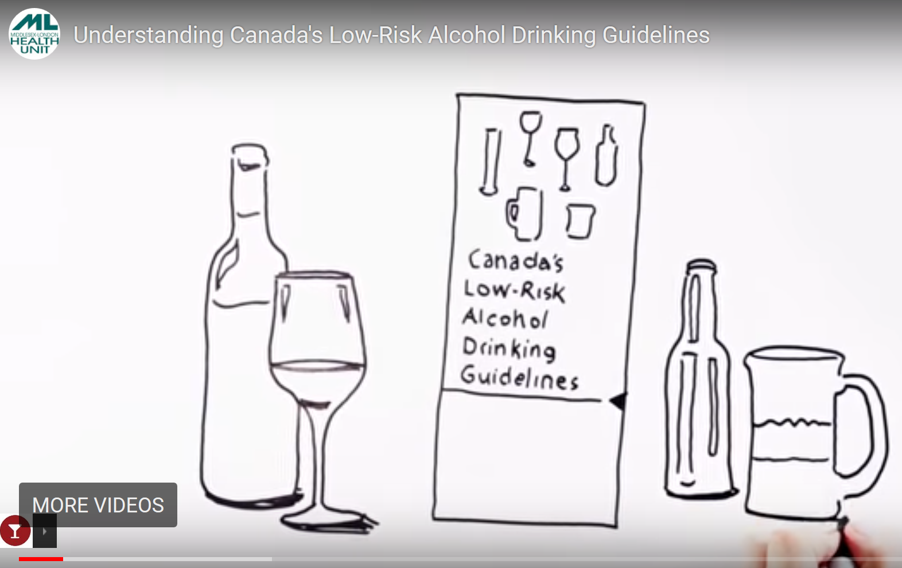

Low Risk Drinking Guidelines
Video
https://youtu.be/NbpdMFE-AIE
Notes:
Important to note that these guidelines apply to adults of drinking age (>19 years).
Reference:
Rethink Your Drinking (2016). Guidelines. Retrieved from http://www.rethinkyourdrinking.ca/information/

Slide 24
Alcohol and Medication
Mixing alcohol with medication can put you at risk for dangerous reactions
Can make medication less effective (or useless), can intensify side effects (drowsiness, nausea, dizziness, etc.) and can even cause severe medical problems (bleeding, breathing difficulties, heart problems, etc.)
Interactions even if not taken at the same time
Speak to a pharmacist to see if there is a reaction with alcohol
Notes:
References:
Butt et. al (2011). Alcohol and Health in Canada: A Summary of Evidence and Guidelines for Low-Risk Drinking. Retrieved from http://www.ccdus.ca/Resource%20Library/2011-Summary-of-Evidence-and-Guidelines-for-Low-Risk%20Drinking-en.pdf
Centre for Addiction and Mental Health. (2018). Do You Know…Alcohol. Retrieved from
http://www.camhx.ca/About_Addiction_Mental_Health/Drug_and_Addiction_Information/alcohol_dyk.html

Slide 25
Myth or fact?
You can drink 1 beer and still be legal to drive if you’re under 22 years age.
FACT
You must have 0% blood alcohol concentration if you are driving under 22 years of age.
22
Notes:
Government of Canada (2018). Drinking and Driving Laws – Criminal Code of Canada. Retrieved from http://laws-lois.justice.gc.ca/eng/acts/C-46/section-255.html

Slide 26
The Law
The Liquor Control Act prohibits the sale of alcoholic beverages to any person under the age of 19, and prohibits the sale of alcohol to an intoxicated person
Drinking and Driving laws are extensive
  Impaired driving causing bodily harm – Maximum Sentence:
  10 Years in Prison
  Impaired driving causing death – Maximum sentence:
  Life Imprisonment
Owner/Operator Liability
Notes:
References:
Government of Canada (2018). Drinking and Driving Laws – Criminal Code of Canada. Retrieved from http://laws-lois.justice.gc.ca/eng/acts/C-46/section-255.html
Government of Ontario (2017). Liquor License Act. Retrieved from https://www.ontario.ca/laws/statute/90l19

Slide 27
“New” Law
As of August 1st, 2010 – Any driver 21 and under and novice drivers must have ZERO ( 0%) Blood Alcohol Concentration = NO Alcohol .
As of July 1, 2018 - Young and novice drivers will also be prohibited from having any presence of cannabis in their system as well as other drugs.
Notes:
Ontario Ministry of Transportation (2018). Impaired Driving. Retrieved from http://www.mto.gov.on.ca/english/safety/impaired-driving.shtml

Slide 28
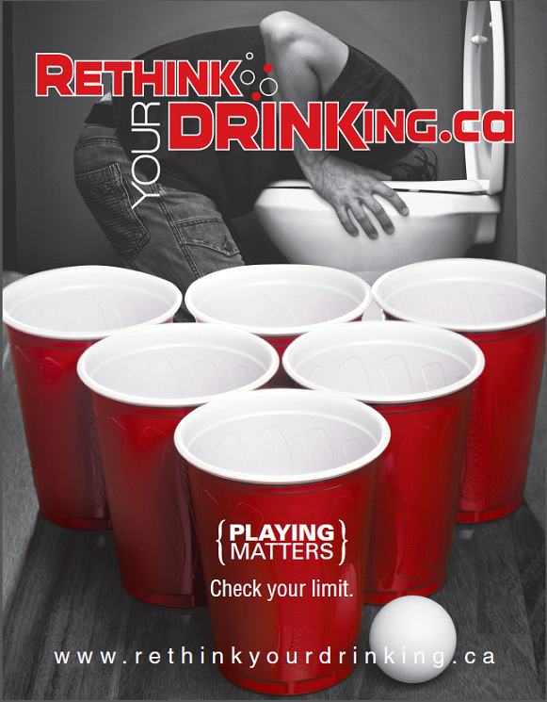
Playing Matters
Drinking games result in a large amount of alcohol being consumed in a short amount of time
Examples include: Century Club, Beer Pong, Kings, Chug-A-Lug, Flip Cup
Get caught up in the “game” and lose track of how much has been consumed
Notes:
Its difficult to remember your limits when they are being pushed by the atmosphere of playing the game. We can quickly consume above and beyond what our bodies can handle when we participate in drinking games.
Reference:
Rethink Your Drinking (2016). Risky Drinking. Retrieved from http://www.rethinkyourdrinking.ca/playing-matters/

Slide 29
Community Supports
Your Doctor or Nurse Practitioner
Your School Nurse
School Social Worker

Slide 30
Community Supports
Notes:
TVAS-numerous programs staffed by professionals- support, education and treatment. Services are free and confidential.
CAMH- educational, web-based, research- programs based in Toronto. The Youth Addiction and Concurrent Disorders Service (YACDS) offers treatment to young people (14 to 24 years) who have substance use challenges/concerns, with or without concurrent mental health concerns, and to their families.
Connex- Access to Addiction, Mental Health, and Problem Gambling Services. ConnexOntario provides free and confidential health services information for people experiencing problems with alcohol and drugs, mental illness or gambling. Funded by the Government of Ontario. Helpline is 24/7, confidential and free.

Slide 31
Community Supports
Notes:
CMHA- Promotes good mental health, prevent further illness, offer treatment, support recovery and provide mental health education in the communities of London, Middlesex, Exeter and Goderich.
Reach Out is a confidential 24/7 information, support and crisis service for people living with mental health or addictions concerns in Elgin, Oxford, Middlesex and London.

